Slide 1


Cloud Infrastructure Week#2
Emrah Mutlu
January 2024

Slide 2
AGENDA – WEEK#2
Data, Data Types, Databases
Cloud Storage Services
Cloud Database Services
Caching
Data Redundancy & Replication
Database Migration to Cloud
Data Security
Lab Sessions:
Lab: Testing replication & disaster recovery scenarios on Cloud
Lab: Creating an SQL DB on Cloud
Lab: Creating a File Share on Cloud

Slide 3
Data, Data Types & Databases

Slide 4
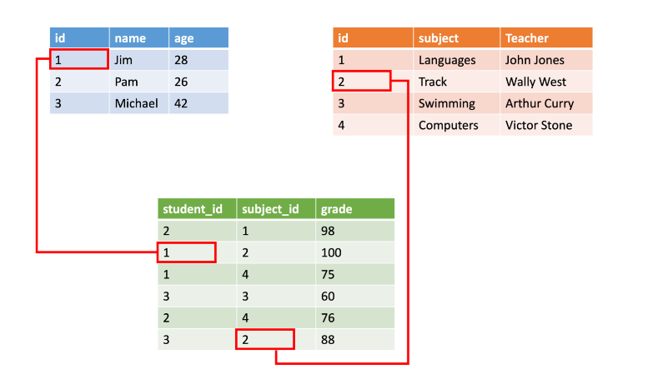
DATA & DATA Types
Data: In the pursuit of knowledge, data is a collection of discrete values that convey information, describing quantity, quality, fact, statistics, other basic units of meaning, or simply sequences of symbols that may be further interpreted.
Examples of data types: Media files (videos, photos, etc.), business data (mail, product catalogs, etc.), financial data, sensor data, etc.
Classification of Data Types:
1. Structured Data: Structured data, sometimes referred to as relational data, is data that adheres to a strict schema, so all of the data has the same fields or properties. The shared schema allows this type of data to be easily searched with query languages such as SQL (Structured Query Language).

Slide 5
DATA & DATA Types
2. Semi-Structured Data: Semi-structured data is less organized than structured data, and is not stored in a relational format, as the fields do not neatly fit into tables, rows, and columns. Semi-structured data contains tags that make the organization and hierarchy of the data apparent - for example, key/value pairs. Semi-structured data is also referred to as non-relational or NoSQL data. The expression and structure of the data in this style is defined by a serialization language (XML, YAML, JSON).
XML
JSON
YAML

Slide 6
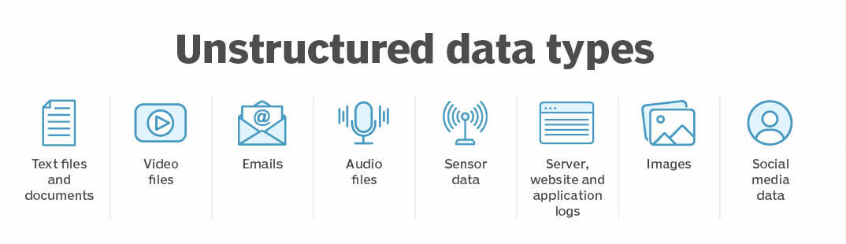
DATA & DATA Types
3. Unstructured Data: The organization of unstructured data is ambiguous. Unstructured data is often delivered in files, such as photos or videos.
Examples of unstructured data include;
Media files, such as photos, videos, and audio files
Office files, such as Word documents
Text files
Log files

Slide 7
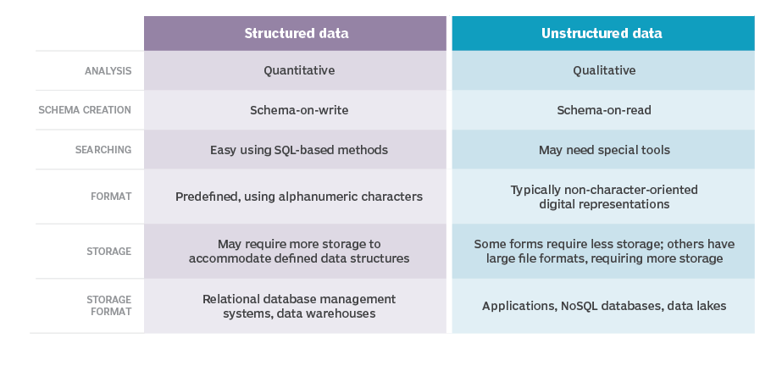
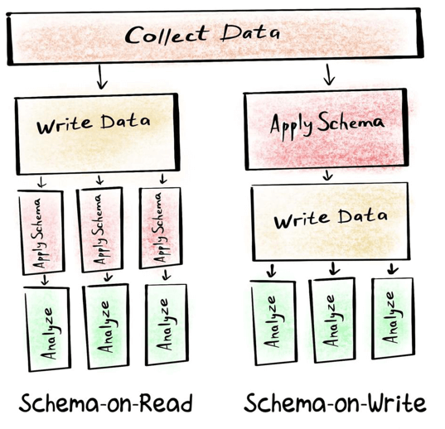
DIFFERENCES BETWEEN STRUCTURED AND UNSTRUCTURED DATA

Slide 8
Q&a
Define the types of the following data types:
Product catalog data
Product catalog data contains the following;
Product SKU
Description
Quantity
Price
Size
Color
Photo / Video, etc.
However, when a new feature is defined (like a Bluetooth featured shoes), this new feature will require a new schema. As a result, the data will not be homogenous (since adding this new feature to all existing shoes will be a cost).
Answer: Semi-Structured Data

Slide 9
Q&a
Define the types of the following data types:
Business data
Business data may contain the following types:
Sales data
KPI (Key Performance Indicator) data
Finance data
Should be comparable with previous months
Should be visualized via BI (Business Intelligence) tools like PowerBI
Should be evaluated through the pipelines
Answer: Structured Data

Slide 10
Q&a
Define the types of the following data types:
Industry 4.0 data
Industry 4.0 data may contain the following types:
Data coming from various types of sensors (IoT)
Processed data from Edge devices
Unprocessed data from local resources
ERP (Enterprise Resource Planning) data from ERP systems
HMI (Human Machine Interface) data from HMI devices
AR/VR data from planning systems
As a result, a big data system that contains both structured & unstructured data
Answer: Unstructured Data

Slide 11
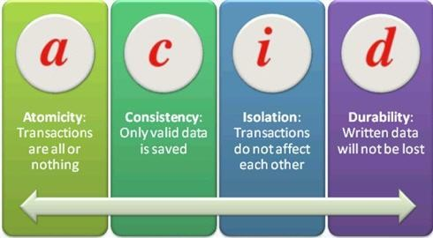
TRANSACTION
Transaction: A transaction is a logical group of database operations that execute together.
If a change in a piece of data will impact another, then Transaction is required.
Transactions are often defined by a set of four requirements, referred to as ACID guarantees. ACID stands for Atomicity, Consistency, Isolation, and Durability:
Atomicity means a transaction must execute exactly once and must be atomic; either all of the work is done, or none of it is. Operations within a transaction usually share a common intent and are interdependent.
Consistency ensures that the data is consistent both before and after the transaction.
Isolation ensures that one transaction is not impacted by another transaction.
Durability means that the changes made due to the transaction are permanently saved in the system. Committed data is saved by the system so that even in the event of a failure and system restart, the data is available in its correct state.
When a database offers ACID guarantees, these principles are applied to any transactions in a consistent manner.

Slide 12
OLTP & OLAP
Transactional databases are generally called OLTP (Online Transaction Processing) systems.
OLTP systems;
Supports lots of users
Have quick response times
Handle large volumes of data
Has HA (Highly available) structure
Typically handle small or relatively simple transactions.
OLAP (Online Analytical Processing) systems;
Commonly support fewer users
Have longer response times
Can be less available
Typically handle large and complex transactions.

Slide 13
Q&a
Define the types of the following needs (OLTP or OLAP):
Product Catalog Data
Photos & Videos
Business Data
Product Catalog Data: Transaction is a must especially on payments, inventory updates, etc. → OLTP
Photos & Videos: These files are changed when a change in the file itself, no transaction requirement.
Business Data: All the data is historical and not changing, so no transaction requirement. → OLAP

Slide 14
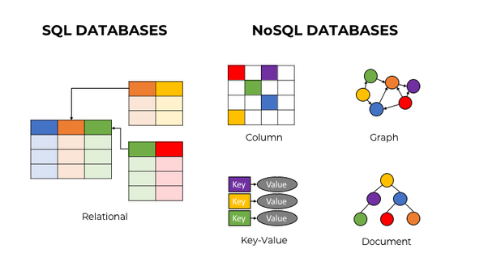
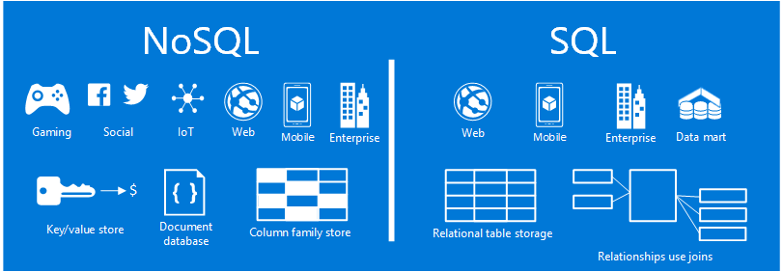
SQL vs NoSQL

Slide 15
SQL vs NoSQL
SQL | NoSQL
RELATIONAL DATABASE MANAGEMENT SYSTEM (RDBMS) | Non-relational or distributed database system.
These databases have fixed or static or predefined schema | They have a dynamic schema
These databases are not suited for hierarchical data storage. | These databases are best suited for hierarchical data storage.
These databases are best suited for complex queries | These databases are not so good for complex queries
Vertically Scalable | Horizontally scalable
Follows ACID property | Follows CAP (consistency, availability, partition tolerance)
Examples: MySQL, PostgreSQL, Oracle, MS-SQL Server, etc | Examples: MongoDB, HBase, Neo4j, Cassandra, etc

Slide 16
Cloud Database Services

Slide 17
Cloud DATABASE servıceS (AZURE)
Customer Support
IF YOU WANT TO | USE THIS
Build modern cloud applications with an always up-to-date relational database service that includes serverless compute, hyperscale storage, and AI-powered and automated features to optimize performance and durability | Azure SQL Database
Migrate your SQL workloads to Azure while maintaining complete SQL Server compatibility, with all the benefits of a fully managed and evergreen PaaS | Azure SQL Managed Instance
Migrate your SQL workloads to Azure while maintaining complete SQL Server compatibility and operating system-level access | SQL Server on Virtual Machines
Build scalable, secure, and fully managed enterprise-ready apps on open-source PostgreSQL, scale out single-node PostgreSQL with high performance, or migrate PostgreSQL and Oracle workloads to the cloud | Azure Database for PostgreSQL
Deliver high availability and elastic scaling to open-source mobile and web apps with a managed community MySQL database service, or migrate MySQL workloads to the cloud. Supports LAMP stack (Linux, Apache, MySQL, PHP). | Azure Database for MySQL
Deliver high availability and elastic scaling to open-source mobile and web apps with a managed community MariaDB database service | Azure Database for MariaDB
Build applications with guaranteed low latency and high availability anywhere, at any scale, or migrate Cassandra, MongoDB, and other NoSQL workloads to the cloud | Azure Cosmos DB
Power fast, scalable applications with an open-source-compatible in-memory data store | Azure Cache for Redis
Accelerate your transition to the cloud using a simple, self-guided migration process | Azure Database Migration Service

Slide 18
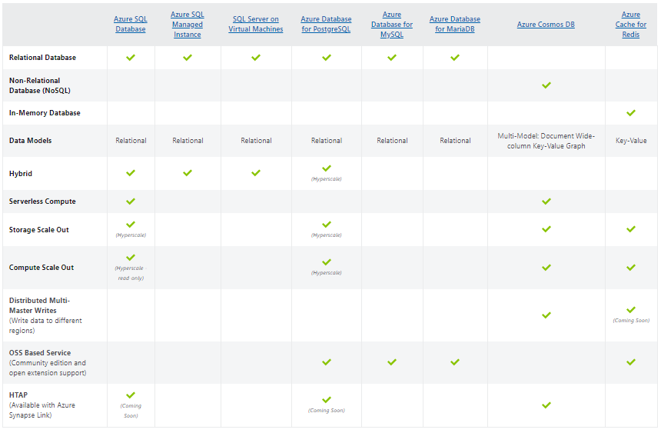
COMPARISION OF DATABASE SERVICES

Slide 19
Cloud Storage Services

Slide 20
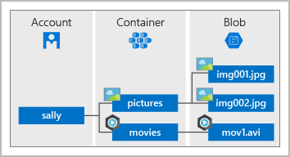
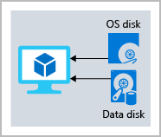
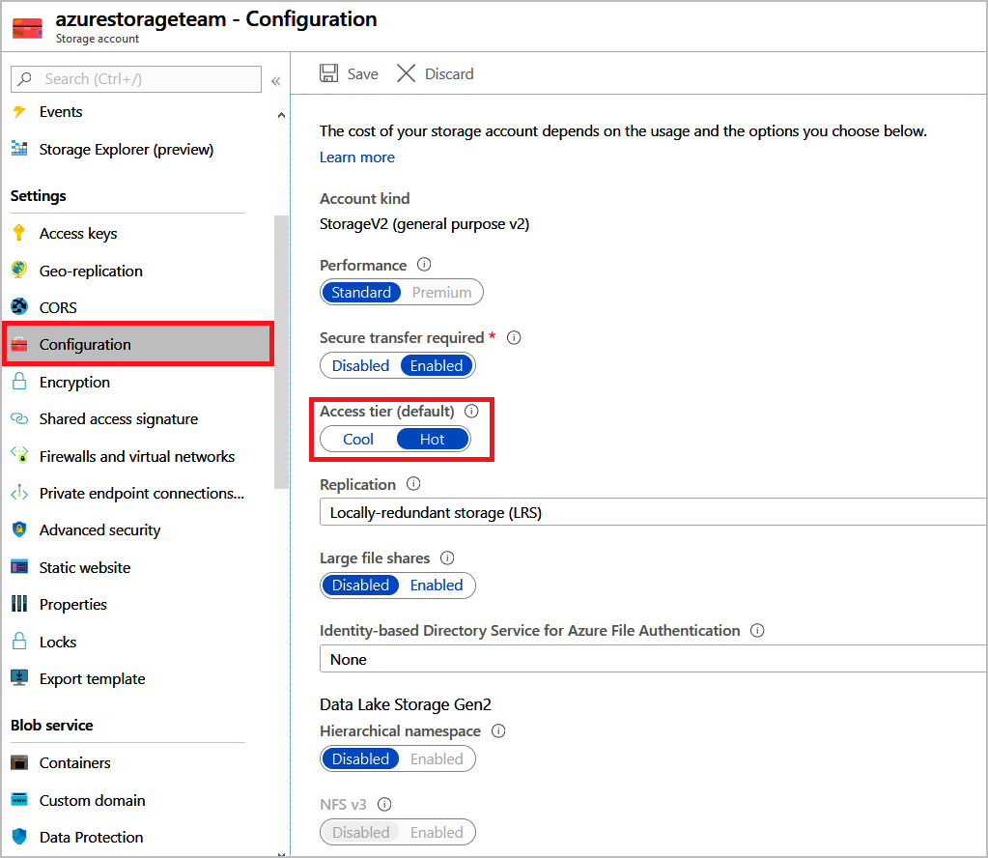
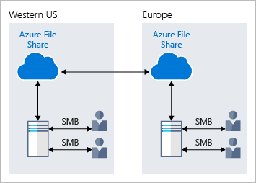
Cloud STORAGE servıceS (azure)
Customer Support
Service name | Service function
Azure Blob storage | Storage service for very large objects, such as video files or bitmaps (Containers).
Azure File storage | File shares that can be accessed and managed like a file server.
Azure Queue storage | A data store for queuing and reliably delivering messages between applications.
Azure Table storage | A NoSQL store that hosts unstructured data independent of any schema.
Azure Storage offers different access tiers for your blob storage, helping you store object data in the most cost-effective manner. The available access tiers include:
Hot access tier: Optimized for storing data that is accessed frequently (for example, images for your website).
Cool access tier: Optimized for data that is infrequently accessed and stored for at least 30 days (for example, invoices for your customers).
Archive access tier: Appropriate for data that is rarely accessed and stored for at least 180 days, with flexible latency requirements (for example, long-term backups).
* Azure VMs use Azure Disk Storage to store virtual disks. However, you can't use Azure Disk Storage to store a disk outside of a virtual machine.

Slide 21
Q&A
Based on the DB types & storage services, determine the best DB / Storage to these services:
Product Catalog Data
Photos & Videos
Business Data
Tip: Define the data classification, operation volume, latency, throughput and transaction needs before answering the question.
You have 5 minutes ☺

Slide 22
Q&A
Product Catalog Data
Data Classification: Semi-structured (changing the products, etc.)
Operations: Customers require high number of read operations, business need high number of write operations
Latency & Throughput: High throughput & low latency
Transaction Support: Required
Recommended Solution: Azure Cosmos DB
Why?
NoSQL DB requirement
Transaction support / ACID compliant
Replication support for operation
Supports several consistency levels for the optimized throughput & latency
Why not other solutions?

Slide 23
Q&A
Photos & Videos
Data Classification: Unstructured
Operations: Need to be retrieved by ID, high number of read by customers with low latency, create/modify operations will be infrequent, could tolerate high latency.
Latency & Throughput: Retrievals by ID need to support low latency and high throughput. Creates and updates can have higher latency than read operations.
Transaction Support: Not required
Recommended Solution: Azure Blob Storage
Why?
Best place to home photos & videos
Supports Azure CDN (Content Delivery Network) for Edge servers to store frequently reached files
Tiered approach (Hot, Cool, Archive) for better pricing / performance
Why not other solutions?

Slide 24
Q&A
Business Data
Data Classification: Structured (stable data, not changing)
Operations: Read-only, complex analytical queries across multiple databases
Latency & Throughput: Some latency in the results is expected based on the complex nature of the queries.
Transaction Support: Not required
Recommended Solution: Azure SQL Database
Why?
SQL DB requirement
Transaction support / ACID compliant
Works better with BI tools (PowerBI, etc.)
Cross-database query support for data analysis
SQL Query Support for data analysis
Why not other solutions? (Azure Synapse, Azure Analysis Services, Azure Stream Analytics)

Slide 25
Caching

Slide 26
CACHING
Caching: Caching is a common technique that aims to improve the performance and scalability of a system. It caches data by temporarily copying frequently accessed data to fast storage that's located close to the application. If this fast data storage is located closer to the application than the original source, then caching can significantly improve response times for client applications by serving data more quickly.
Caching is most effective when a client instance repeatedly reads the same data, especially if all the following conditions apply to the original data store:
It remains relatively static.
It's slow compared to the speed of the cache.
It's subject to a high level of contention.
It's far away when network latency can cause access to be slow.
Caching in distributed applications
Distributed applications typically implement either or both of the following strategies when caching data:
They use a private cache, where data is held locally on the computer that's running an instance of an application or service.
They use a shared cache, serving as a common source that can be accessed by multiple processes and machines.
In both cases, caching can be performed client-side and server-side. Client-side caching is done by the process that provides the user interface for a system, such as a web browser or desktop application. Server-side caching is done by the process that provides the business services that are running remotely.

Slide 27
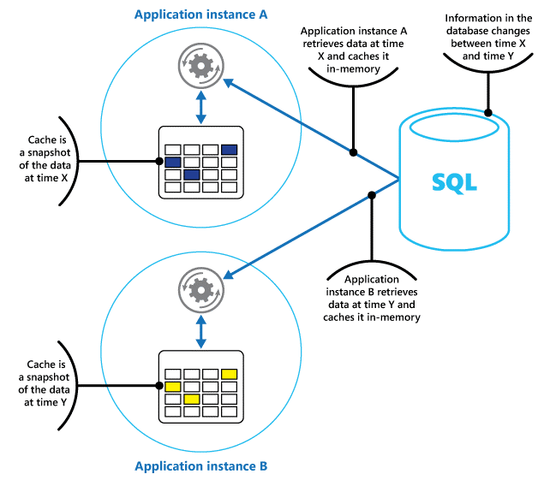
CACHING TYPES
Private Caching: The most basic type of cache is an in-memory store. It's held in the address space of a single process and accessed directly by the code that runs in that process. This type of cache is quick to access. It can also provide an effective means for storing modest amounts of static data. The size of a cache is typically constrained by the amount of memory available on the machine that hosts the process.
Private Caching

Slide 28
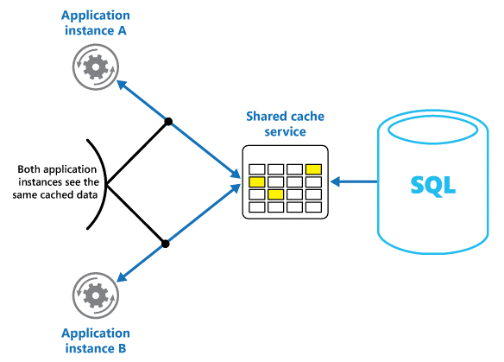
CACHING TYPES
Shared Caching: If you use a shared cache, it can help alleviate concerns that data might differ in each cache, which can occur with in-memory caching. Shared caching ensures that different application instances see the same view of cached data. It locates the cache in a separate location, which is typically hosted as part of a separate service.
Shared Caching

Slide 29
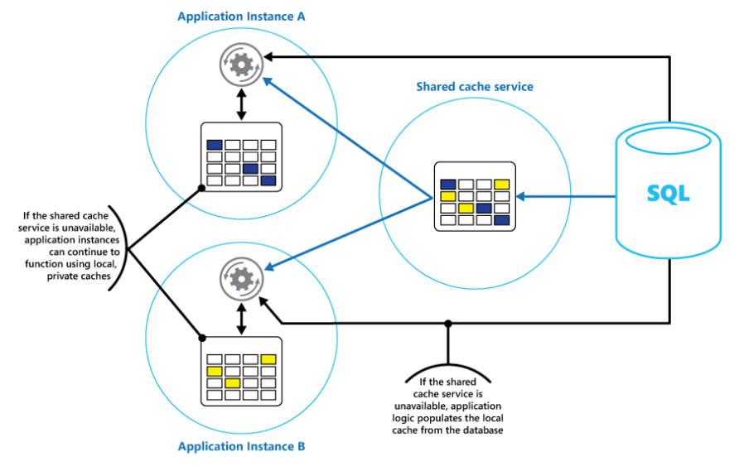
CACHING TYPES
Mixed Caching: A combination of both Private and Shared caching for high available / BC App. scenario.
Mixed Caching

Slide 30
Data Redundancy & Replication

Slide 31
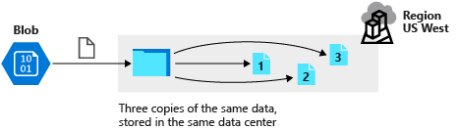
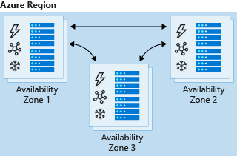
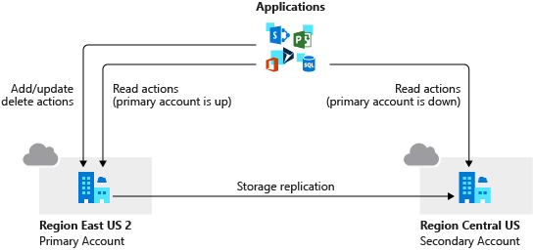
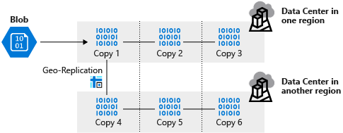
Data Redundancy
Data redundancy: Data in Azure is replicated to ensure that it's always available, even if a datacenter or region becomes inaccessible or a specific piece of hardware fails. You have the following replication options:
Locally redundant storage (LRS)
Zone-redundant storage (ZRS)
Geographically redundant storage (GRS)
Read-access geo-redundant storage (RA-GRS)
Geo-zone-redundant storage (GZRS)
Read-access geo-zone-redundant storage (RA-GZRS)
Each replication option provides a different level of redundancy and durability.

Slide 32
DATA REDUNDANCY COMPARISION
Replication type | Copies | Use case
LRS | 3 | Data remains highly available, but for compliance reasons, isn't allowed to leave the local datacenter.
ZRS | 3 | Need redundancy in multiple physical locations, but because of compliance, data isn't allowed to leave a region.
GRS | 6 | App has access to the data, even if an entire region has an outage.
RA-GRS | 6 | App reads from multiple geographical locations, so you can serve users from a location that's closer to them.
GZRS | 6 | App can access data, even if the primary region has failed, and your secondary region has a datacenter that's experiencing an outage. But you don't want to read from the secondary region unless the primary region is down.
RA-GZRS | 6 | Regularly read data from your secondary region, perhaps to serve users from a location closer to them, even if a datacenter is up in your primary region.

Slide 33

REPLICATION
Replication: Replication is used for business continuity and disaster recovery scenarios. Each DB has a different replication technique in Azure.
RTO (Recovery Time Objective) and RPO (Recovery Point Objective) are the main criteria while designing replication:
RTO: An RTO is a measure of the maximum amount of time your business can survive after a disaster before normal service is restored. Let's assume your RTO is 12 hours, which means that operations can continue for 12 hours without the business's core services functioning. If the downtime is 24 hours, your business would be seriously harmed.
RPO: An RPO is a measure of the maximum amount of data loss that's acceptable during a disaster. A business can typically decide to do a backup every 24 hours, 12 hours, or even in real time. If a disaster occurs, there's always some data loss.

Slide 34
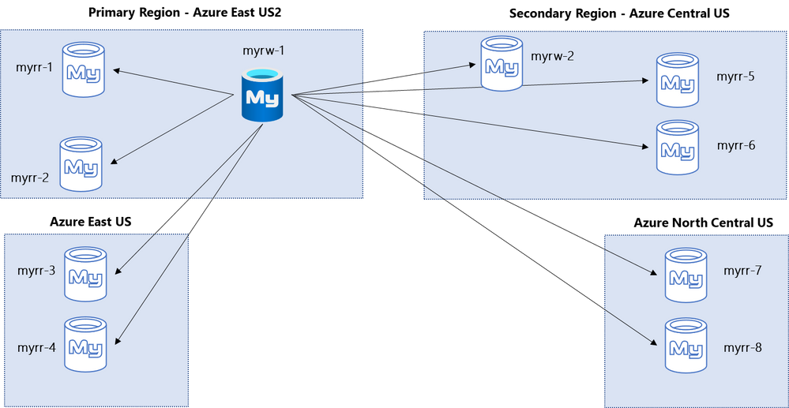
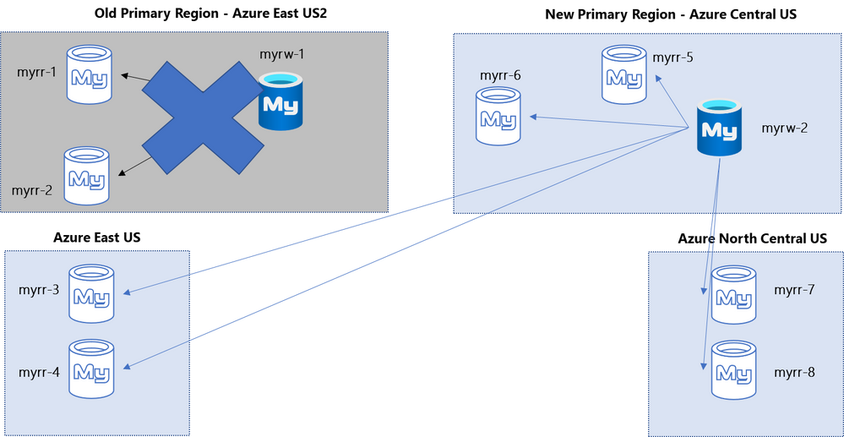
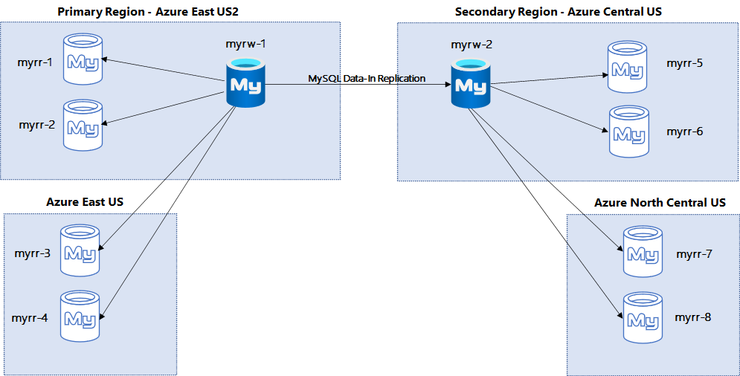
DB REPLICATION EXAMPLE: AZURE DB for MYSQL
Regional
Disaster
Alternate Replication

Slide 35
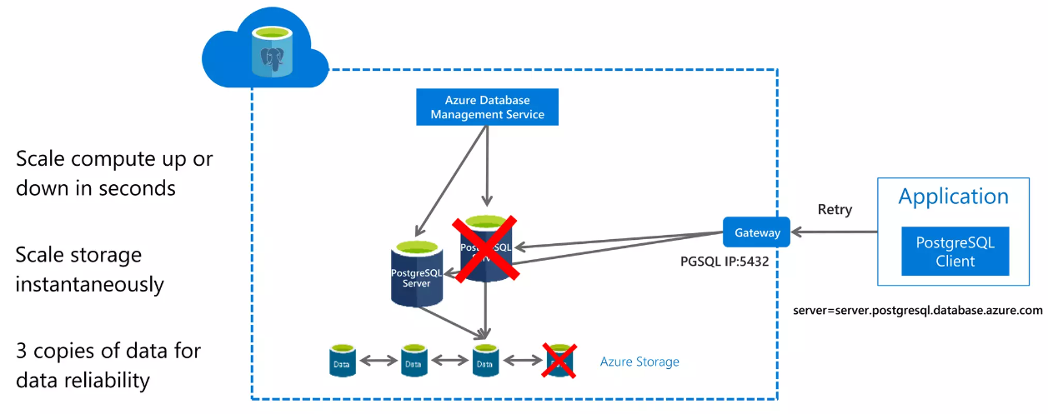
DB REPLICATION EXAMPLE: POSTGRESQL
PostgreSQL DB uses Built-in HA structure that Azure Cloud could control the replication automatically.

Slide 36
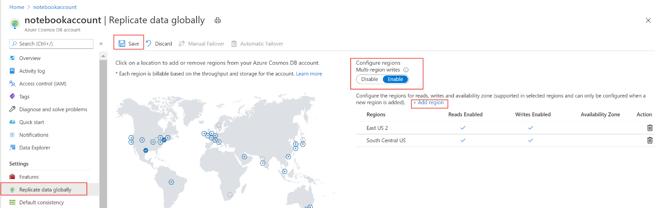
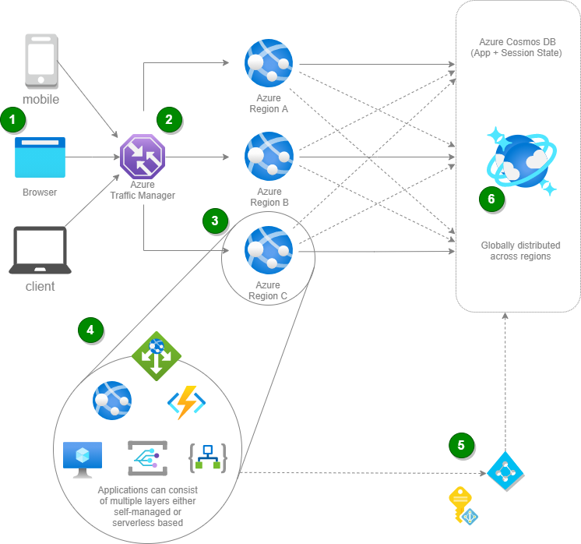
DB REPLICATION EXAMPLE: AZURE COSMOS DB
Azure Cosmos DB uses Built-in multi-region write copies that Azure Cloud could control the replication automatically.

Slide 37
DB Migration to Cloud

Slide 38
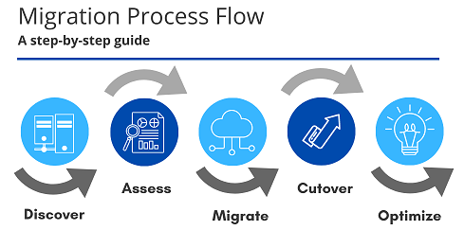
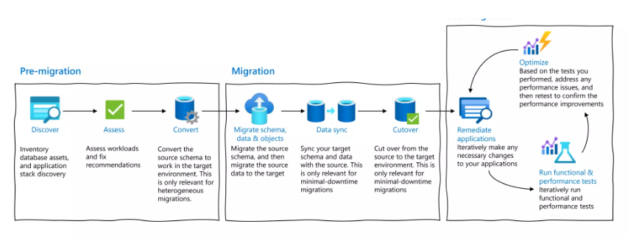
DB MIGRATIONS
Migration to Cloud is a step-by-step procedure to be succeeded.
Steps are;
Discover
Assess
Migrate
Cutover
Optimize

Slide 39
DB MIGRATION EXAMPLE: SQL Server to Azure SQL Managed Instance
Customer has several on-prem SQL servers that contains the following data:
Business Critical Applications and their database
Company critical data (Personal info, financial info, etc.)
CRM data (Customer Relationship Management – opportunities, sales, etc.)
Determine a way forward to move all data to Azure SQL MI.
Steps:
Discover: Use a discovery tool to analyze the needs (Azure Migrate or some 3rd party tools)
Assess: Assess all the needs and determine the migration method;
BC App & CRM: Need low downtime requirement due to business continuity.
Company Data: Do not need low downtime requirements.
Use Azure Migrate Assess tool (or any other 3rd party tool) to assess SQL servers to be migrated.
Review the assessment results and determine the migration method: BC App & CRM: Azure Data Studio for zero downtime / Company Data: Native backup & restore – need some downtime.
Migrate: Use Azure Data Studio to migrate BC App & CRM DBs. Use Backup & Restore to migrate Company data.
Cutover: Perform migration cutover and make changes in the applications to use Azure SQL MI as the primary DB.
Optimize: Perform tests (validation, performance, etc.) and make necessary changes to optimize the workload.

Slide 40
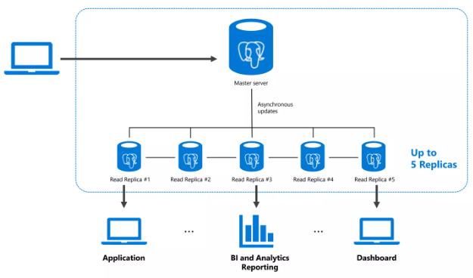
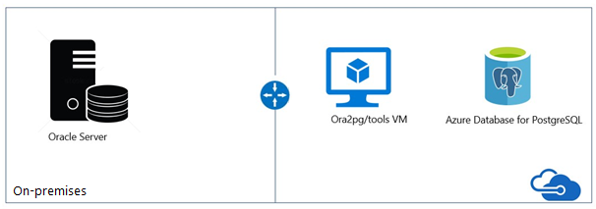
DB MIGRATION EXAMPLE: ORACLE TO POSTGRESQL on AZURE
Oracle to PostgreSQL migration could cause unexpected issues.
The best practices advise to use a 3rd party tool directly to overcome known issues:
Ora2pg tool
Follow the migration process flow explained in Ora2pg.
The Master-Replica infrastructure could be shown as below.

Slide 41
DB MIGRATION GUIDELINES
Follow the link to see more DB migration best practices.
https://learn.microsoft.com/en-us/data-migration/

Slide 42
Data Security

Slide 43
DATA SECURITY
Security is a completely different chapter that we will focus later but would like to summarize a few options about data security.
Cloud systems provide the following guidelines to protect the data;
Encryption at Rest: Storage devices support AES-256, FIPS-140-2 and they are enabled by default, i.e. the data is encrypted automatically. Virtual Disks are encrypted with Disk Encryption algorithms (i.e. BitLocker for Windows, dm-crypt for Linux). Key Manager systems (i.e. Azure Key Vault) stores the keys and secrets, even if these images are downloaded, they cannot be decrypted without these keys/secrets. SQL DBs could protect columns / rows and alert if they are reached.
Encryption in Transit: Transport level security like HTTPS for API calls and SMB 3.0 for File shares.
CORS Support: Cross-Origin Resource Sharing ensures only authenticated services / apps reach to the desired media / docs.
RBAC: Role-Based Access Control ensures authentication and authorization levels are set accordingly.
Access Audit: Storage Analytics tool (in Azure) could log all activities to see which files are reached / denied by which users.
Account Keys: Storage Account keys are provided to the applications for CORS support.
SAS Services: Shared Access Signatures could be defined in service-level or account-level to secure the storage account.
Network Security: Some examples are Firewall, NSG, ASG, WAF, NVA and VPN services (will be explained later).

Slide 44
Lab Session

Slide 45
LAB#3: Testing replication & disaster recovery scenarios on Cloud
Follow the instructions: https://learn.microsoft.com/en-us/training/modules/provide-disaster-recovery-replicate-storage-data/5-exercise-failover-secondary-location

Slide 46
LAB#4: Creating an SQL DB on Cloud
Follow the instructions: https://learn.microsoft.com/en-us/azure/azure-sql/database/single-database-create-quickstart?view=azuresql&tabs=azure-portal

Slide 47
LAB#5: Creating a File Share on Cloud
Follow the instructions: https://learn.microsoft.com/en-us/azure/storage/files/storage-how-to-use-files-portal?tabs=azure-portal

Slide 48
HOMEWORK
Compare AWS and Azure’s DB services. Provide a short summary.
Research and provide a summary about Azure & AWS Backup solutions.
Try to learn more about Network:
Network Devices: https://www.youtube.com/watch?v=H8W9oMNSuwo (30 min. watch)
OSI Reference Model: https://www.youtube.com/watch?v=t-ai8JzhHuY (32 min. watch)
Further Reading:
Comparison of SQL Service vs SQL on Azure VM

Slide 49
Thank You

